Slide 1


Bank of Baroda Hackathon - 2022
Technology Partner
Your Team Name : DST 2022
Date : 19-09-2022

Slide 2
Problem Statement?
Why did you decide to solve this Problem statement?
Contact Center is a very important touch point for customer service. Customers interact with the contact center for a variety of services fulfillment, information about products and services, complaints, feedback, and interactions. For enhancing the contact center service levels, the customer interactions need to be analyzed and need to be mapped with customer satisfaction. Banks want to automate the process with use of AI based techniques to measure and monitor various KPIs such as call data quality, customer sentiment, Call Hygiene, customer satisfaction etc.

Slide 3
User Segment & Pain Points
Which user /advertiser segment would be early adopter of your product & why?
Customer Call complain Analytics ( e.g., Banking , Telecom etc)
Reason:
Banking Companies will get customer psyche and expectation and can act for customer retention.
This new service can add new customer with positive analysis of customer’s feedback
This new service can analyze the performance of customer center.
This new service will help to use one platform for multiple languages.
KPIs will help to gauge the Customer sentiment on a product. Banks want to automate the process with use of AI based techniques to measure and monitor various KPIs such as call data quality, customer sentiment, Call Hygiene, customer satisfaction etc.

Slide 4
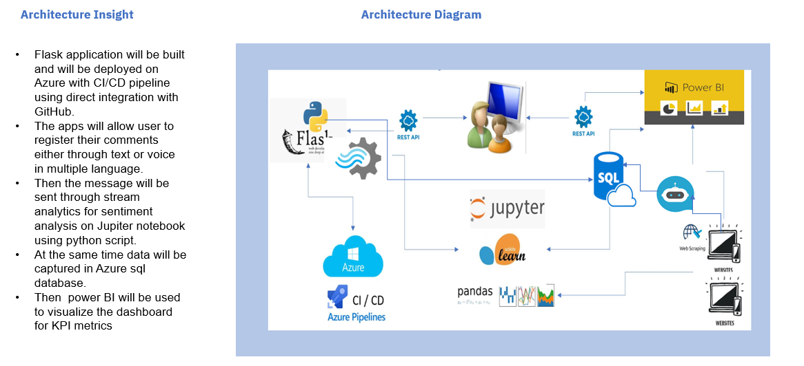
Architecture Details Architecture Details

Slide 5
Pre-Requisite
What are the alternatives/competitive products for the problem you are solving?
Language in which the customer complaint is added through Homepage→Register New Complain , should be entered correctly in the page itself , through the dropdown.
For customer complaint , Under Homepage-->Register new Complain , there is a placeholder for voice recorder( mic) as well , where the speech to text and then subsequent translation of the Non-English language will happen ., and finally the English translated text along with sentiment score , customer satisfaction rating and polarity score , is inserted into the backend storage
The same table , will be used for displaying all the previously lodged complains , under the section Homepage → Previous Complain (BoB Emp Only).
For any customer complaint , having either “credit’ , “debit” , “loan” etc keywords the transaction type of such complains , will be inserted and the same will be available from Homepage → Previous Complain (BoB Emp Only).
Power BI will be used for visualization

Slide 6
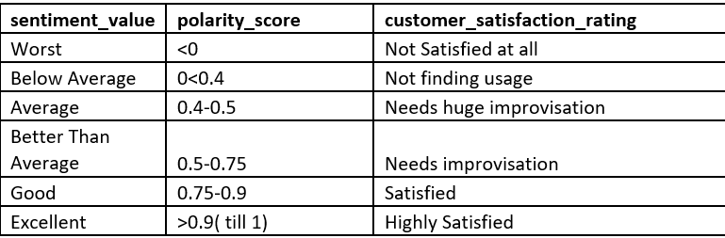
Pre-requisites( contnd..)
The following sentiment values and customer satisfaction rating are applicable , for the various polarity_scores , the output of ML sentiment python package .

Slide 7
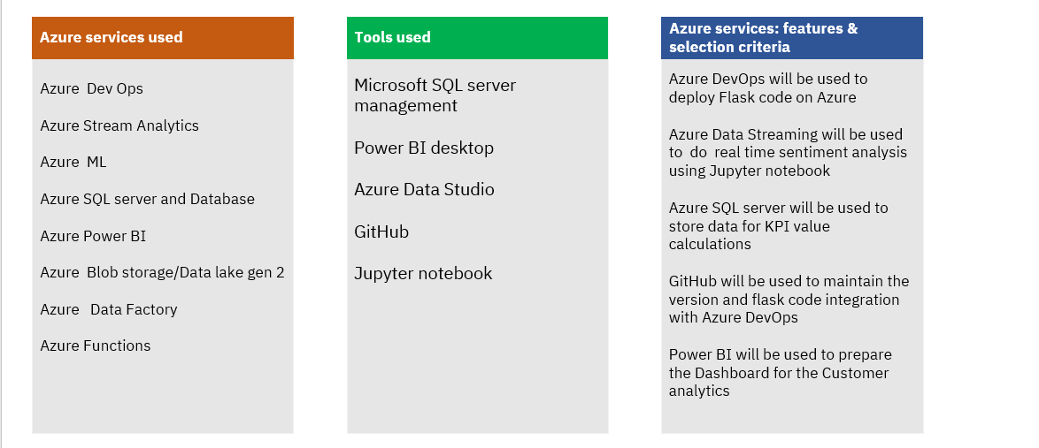
Azure tools or resources

Slide 8
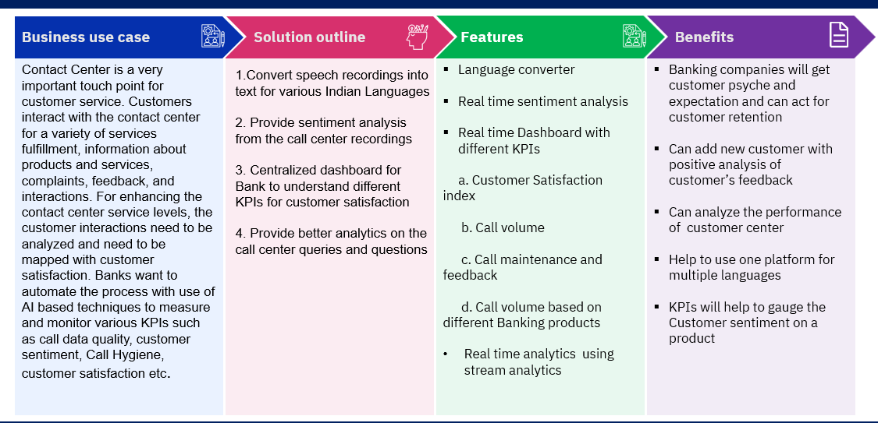
Key Differentiators & Adoption Plan

Slide 9
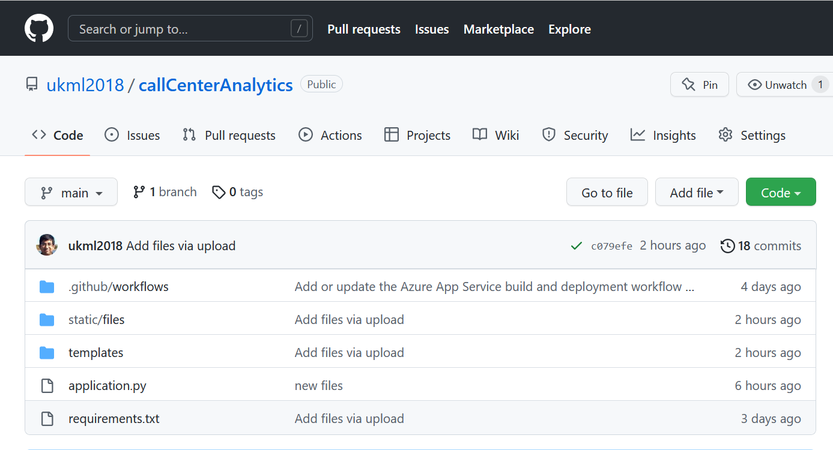
GitHub Repository Link & supporting diagrams, screenshots, if any
Github link for uploaded code :
https://github.com/ukml2018/callCenterAnalytics
Future enhancements:
A Chatbot can be integrated with the service
Login and Authentication process
Streaming process from social media

Slide 10
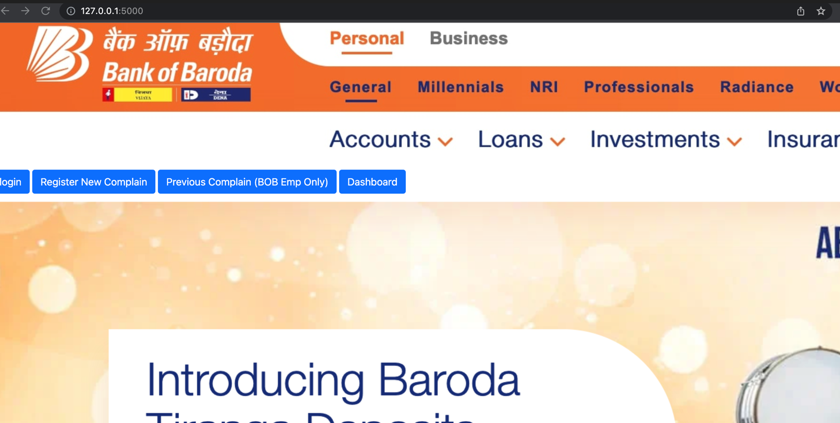
Prototype developed and deployed on Azure (https://callcenteranalyticshekathon.azurewebsites.net)
Landing page:

Slide 11
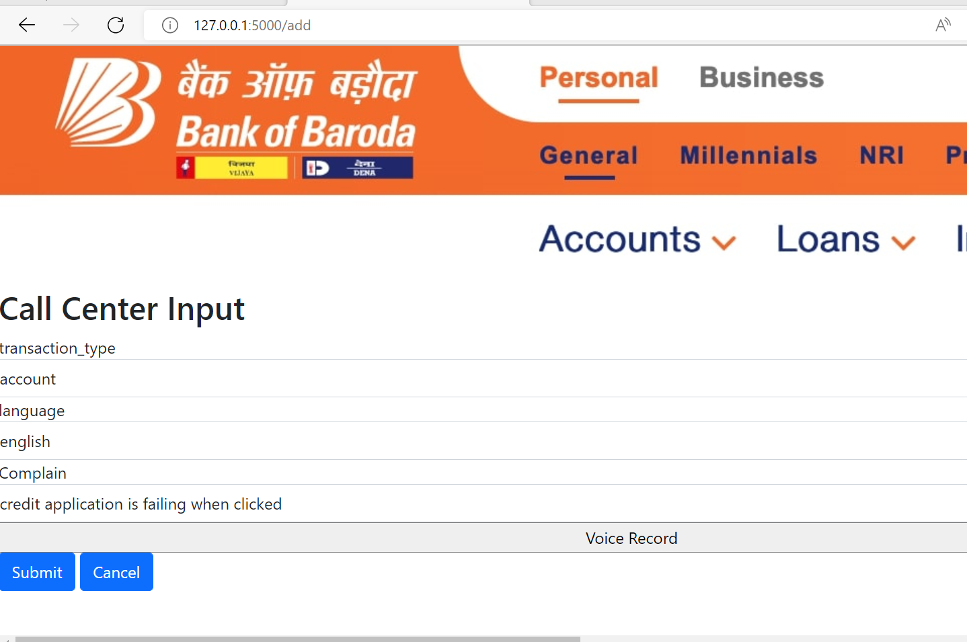
Register New Complain: Both written and Voice recording multi-lingual option

Slide 12
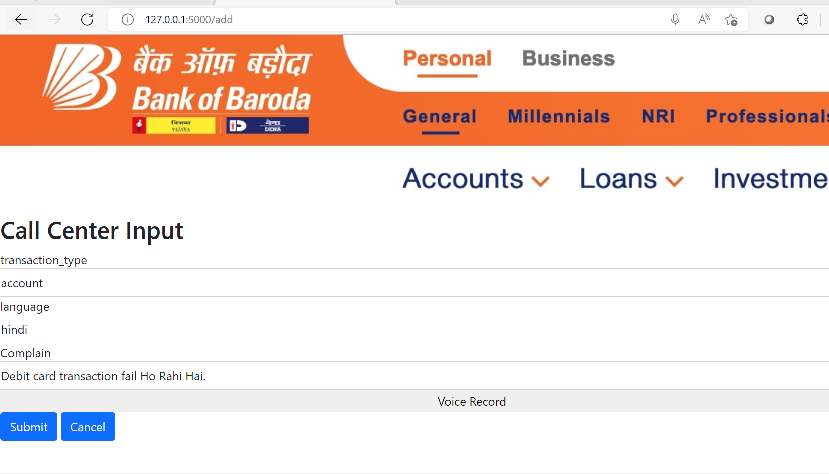
Example:

Slide 13
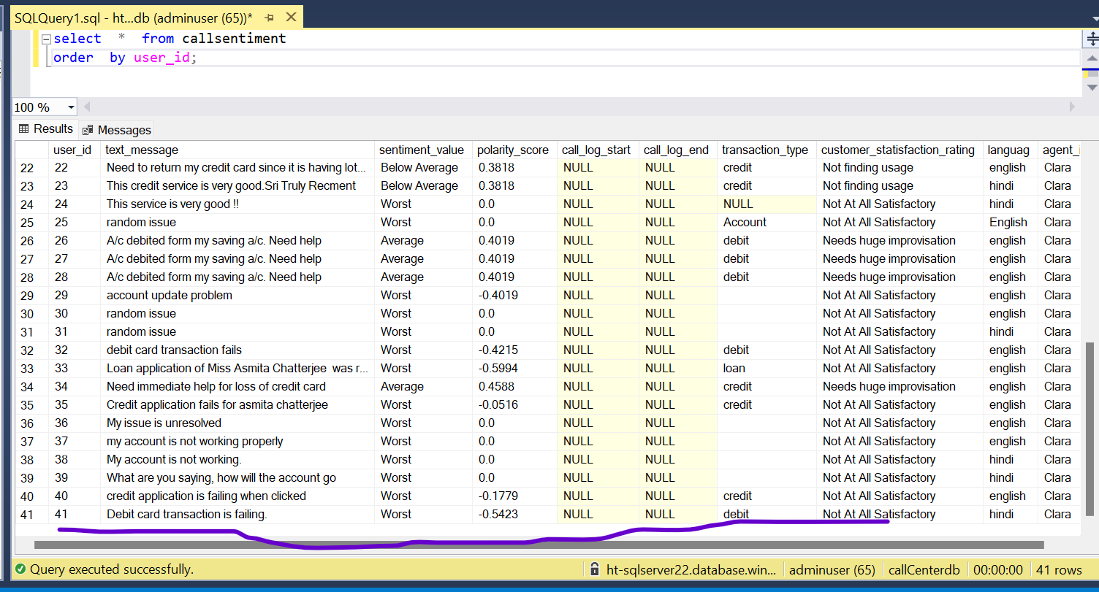
Back end table

Slide 14
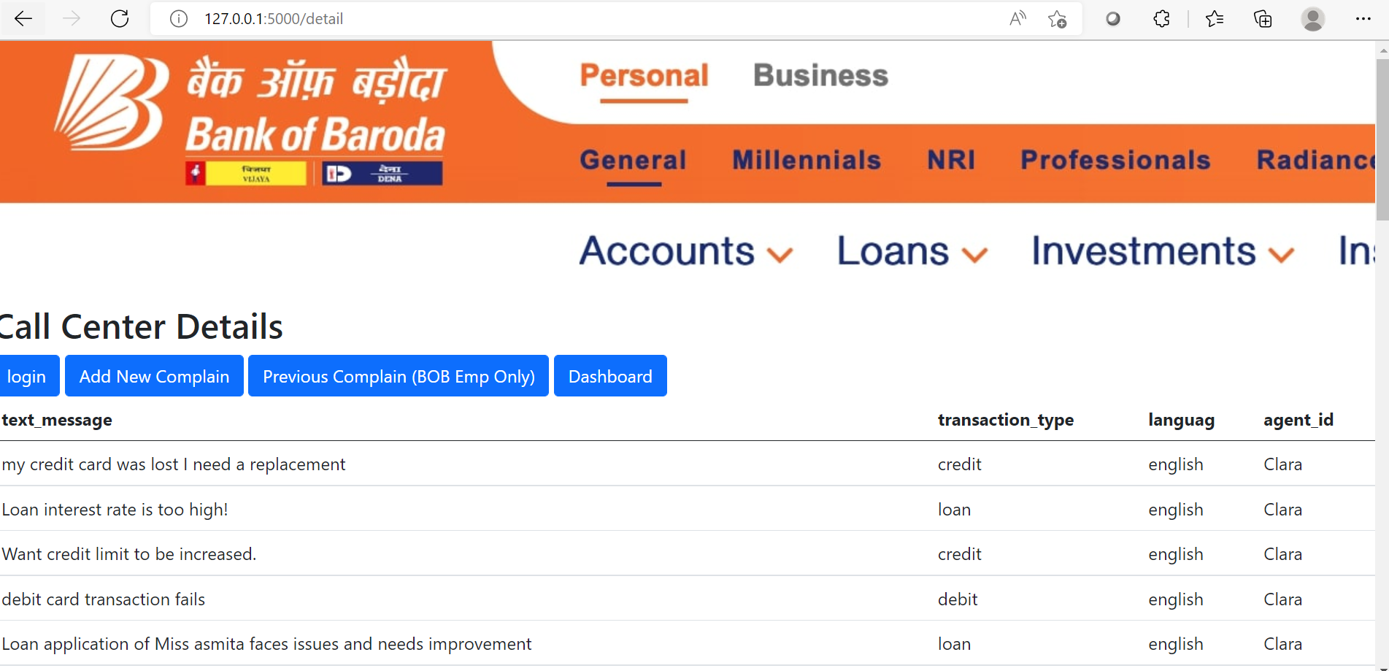
Previous Complain details:

Slide 15
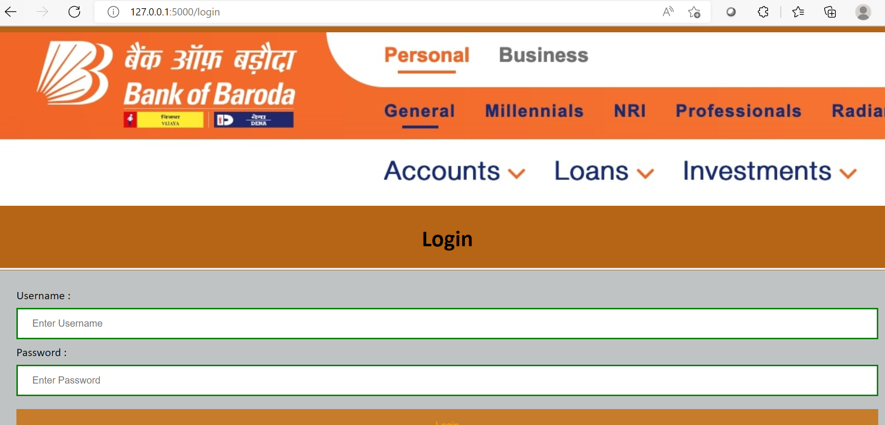
Login Page:

Slide 16
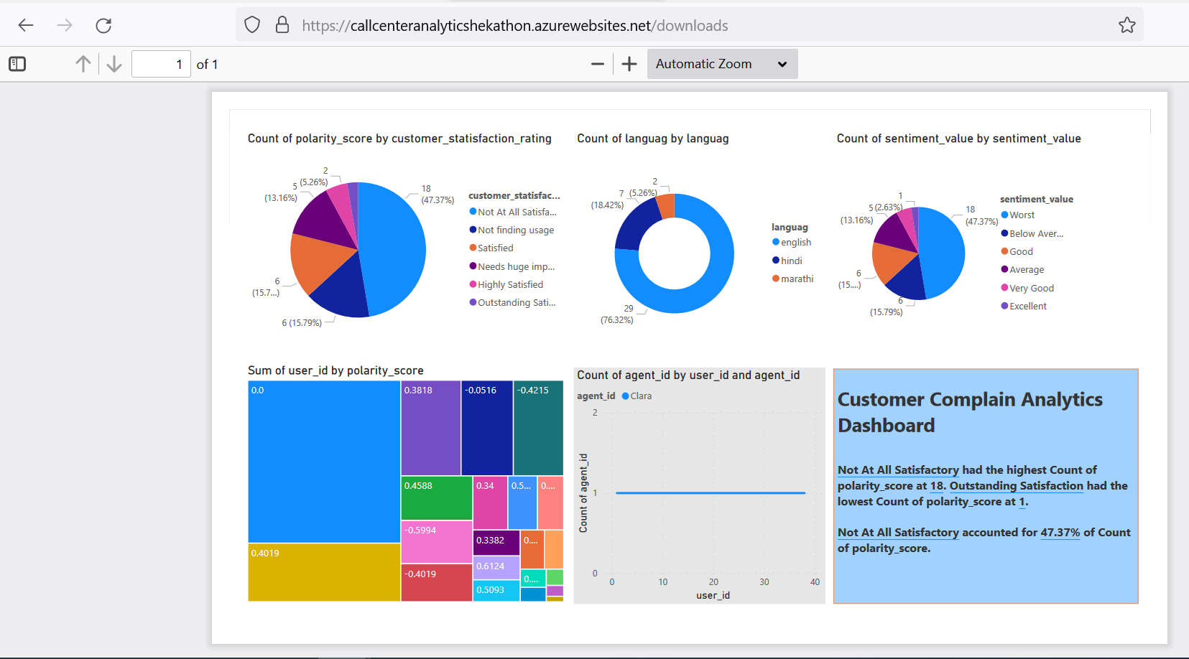
Real-time Power BI Dashboard:

Slide 17
Thank You
Asmita Chatterjee
Amit Agarwal
Uttam Kumar Manna

